Slide 1
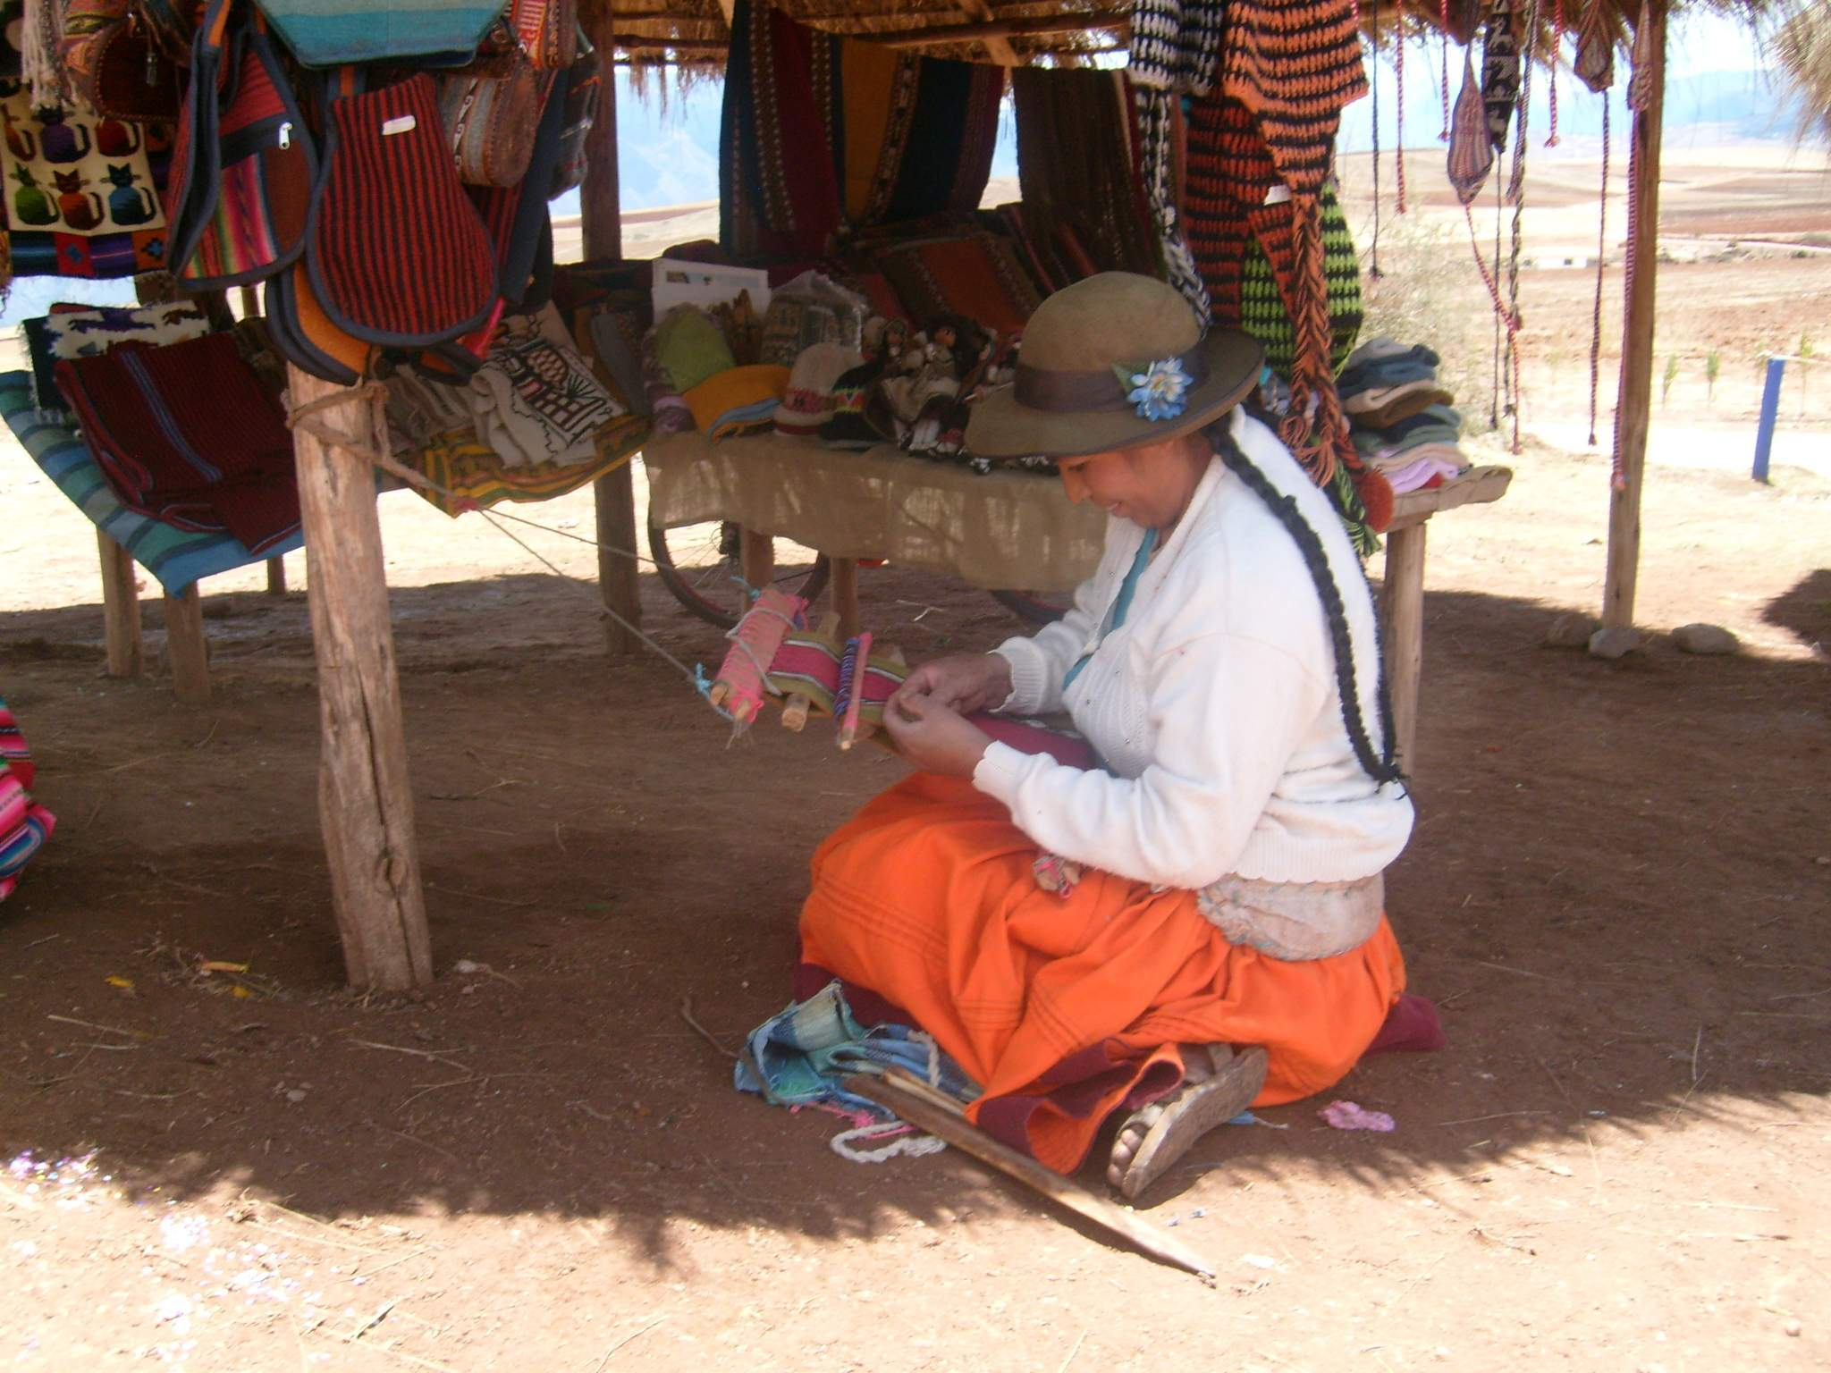
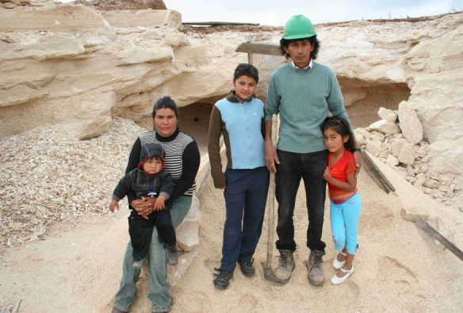
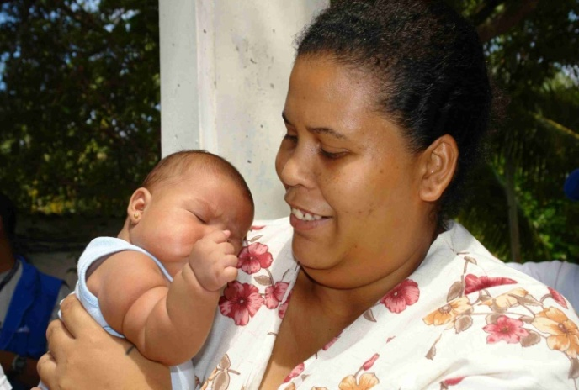
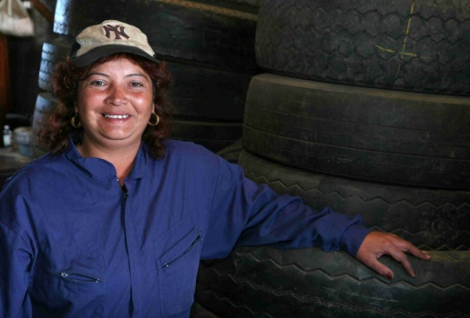
MOVING FORWARD: SAVINGS LINKED CCTs
Carolina Trivelli
Instituto de Estudios Peruanos
September 2011

Slide 2
WHY HELP SAVINGS MOBILIZATION FOR THE POOR?
Deposit accounts, such as savings are at the forefront of formal financial inclusion policies. Formal savings have critical impact for poor communities, such as smoothing consumption and overarching goals in CCTs.
I) THE POOR DO SAVE
II) SAVINGS ACCOUNTS ARE USEFUL FOR THE POOR
Literature on the importance of formal savings for the poor.
The poor already know how to save in traditional ways
Formal savings allows:
Smoothing consumption
Overcoming shocks and emergencies
Accumulating cash to be converted into any required asset
Investing in business and/or home improvement
Having an initial experience with financial institutions, learning process

Slide 3
BECAUSE THE POOR DO SAVE
In contrast to popular assumption, the poor do save (Robinson, 2001).
They, like the non-poor, use a complex assortment of ways to turn small daily earnings into lump sums for investment (Rutherford, 2000).
Likewise, they also take a large inflow of earnings by selling an asset (a cow, for example) and turn it into smaller monthly rations (Vonderlack and Schreiner, 2001).
The poor used thirty-three different services and devices to manage their money; no family used less than 10 different methods (Collins et al, 2009).
But still better savings devices are needed…
Notes:
The method was to have the participants create a ‘financial diary” recording every minute detial of their financial lives, coupled with bi-monthly visits for a full year from the surveyors. In total the team collected 250 complete diaries.

Slide 4
WHY DO WE THINK SAVINGS ACCOUNTS ARE THE FIRST USEFUL TOOL FOR THE POOR?
Security and Reliability
Privacy
Divisibility
Protection of value
Accessibility
Empowerment
Smooth consumption when experiencing volatile income
Opens a relationship with the financial system
Facilitates a financial education process
Allows productive investments
Reduces vulnerability
Generates a useable financial asset that the poor can eventually turn into whatever type of investment they choose or need
1
2
3
4
5
6
7
8
9
10
11
12

Slide 5
PERUVIAN BACKGROUND EXPERIENCES USING FORMAL SAVINGS:
INTRODUCTION TO POOR RURAL FAMILIES TO THE FINANCIAL SYSTEM VIA:
(no cost) MICRO SAVINGS ACCOUNTS
2 STATE-RUN PROGRAMS
1
Proyecto Corredor Puno-Cusco (2001-2008)
2
Proyecto Sierra Sur (2005-2011)
CONTEXT:
Suitable environment ( 2009: Peru ranked an amiable microfinance environment out of 55 countries “Global microscope on the microfinance business environment,”)
Low Inflation
Good microfinance development (Development of formal, regulated, and profitable financial institutions, that have grown through credit and savings in traditionally excluded sectors)

Slide 6
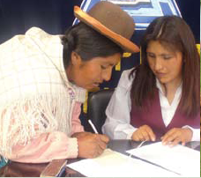
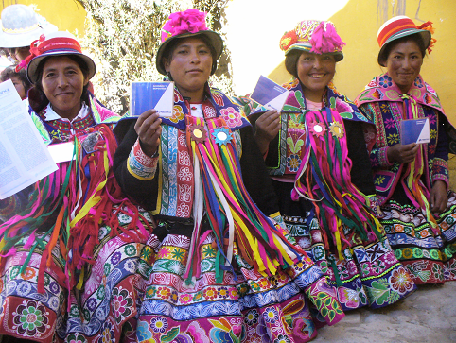
PERUVIAN BACKGROUND EXPERIENCES USING FORMAL SAVINGS:
PROGRAMS AIMING AT:
TARGET POPULATION:
Demonstrating that financial savings are useful for the poorest and the beginning of financial inclusion path.
Poor rural (indigenous) women
Nº BENEFICIARIES:
PROGRAMS’ COMPONENT:
16,000 poor rural women formally included in the financial system
Opening of individual savings accounts…..
+
Financial education
Peer support groups for their individual accounts
Assistance of financial promoters
Monetary incentives to complement each beneficiaries effort
+
+
+

Slide 7
PROYECTO CORREDOR PUNO-CUSCO: INITIAL PILOTS’ RESULTS…
STUDY ON THE 1ST COHORT OF WOMEN SAVERS IN CORREDOR (Trivelli & Yancari, 2008) :
Before: 60% interviewed savers had never enter a bank
Women deposited a total, on average, of US $ 525 in 48th month contract
+
Corredor US $ 110
Interest earned US $ 30
For each participant
Average Balance at the end of the project US $ 256
75 % of the women opened their accounts transforming informal savings
After 8 years (with no project support) in Cusco and Puno, 42 % keeps using the account
(2010: Average Balance US $ 157)
52% of the savings accounts are still open at Credinka (MFI) in Cusco

Slide 8
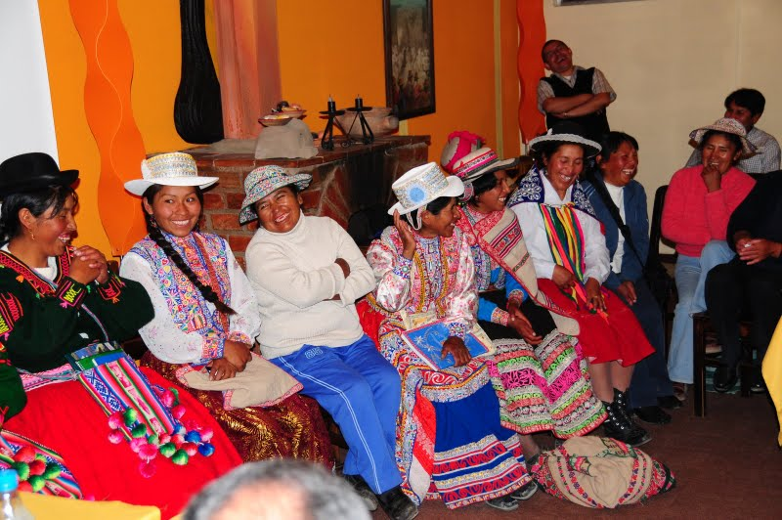
PROYECTO SIERRA SUR:
INITIAL PILOTS’ RESULTS…
Open savings accounts
Buy micro life insurance
Sierra Sur project supported women to :
+
Qualitative study : women easily learn how to use their savings accounts, and indeed use them (36 interviews) 2010 : the average balance in the accounts of the interviewed women was US $ 126
A significant group also bought micro insurance (they value the product, but find it difficult to understand).
As well as with micro life insurance, the main reason for holding a savings account was to face emergencies.
Source: De los Rios, Jessica (2010)

Slide 9
BASED ON THESE RESULTS… PROYECTO CAPITAL PROPOSES SAVINGS LINKED CCTs
WHY CONDITIONAL CASH TRANSFER PROGRAMS SHOULD PROMOTE FINANCIAL INCLUSION PROCESSES?
18+ CCT Programs in LA
26 millions of households receive CCTs.
1
CCT programs and financial inclusion pursue the same objective: they endow the poor with tools to overcome poverty.
Financial inclusion programs help consumption improvements.
Financial inclusion programs help CCT programs’ operative costs reduction.
Savings linked CCTs provide beneficiaries the opportunity to save safely.
Savings linked CCTs have the potential to scale up financial inclusion efforts.
Savings linked CCTs can encourage an adequate supply of financial products the CCT target population.
…. But despite the fact that beneficiaries receive this transfer, there is still much inequality and exclusion in the world, that can be illustrated by taking a first glance at the denied access to Financial Institutions:
77% of the poorest families are disconnected from the financial system.
2
3
4
5
6

Slide 10
SAVINGS LINKED CCTS
We propose an WIN-WIN- WIN alliance among CCTs and Financial Inclusion.
FAMILIES
GOVERNMENTS
FINANCIAL SECTOR
Lower costs to obtain the transfer
Access to wide range of financial products
Vulnerability reduction
Enhanced citizenship
Options to build assets
through savings
Efficiency and transparency
Mid-term Impact
Responsible graduation
Financial inclusion
Outreach (breadth and depth)
Mobilize savings
Piggy back other products
Corporate Social Responsibility
WIN
WIN
WIN
Complementarity of short term (stipend), medium term (savings, credit, insurance) and long term (education and health of kids) effects.

Slide 11
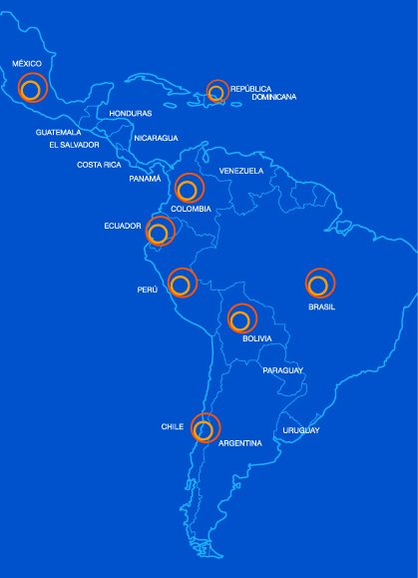
PROYECTO CAPITAL IN THE REGION
Proyecto Capital assists the public sector through Social Protection Programs in various LAC countries that are interested in adding value to and expanding the impact of their current social policies by including complementary models for financial inclusion and promotion of savings.
REGIONAL
PROPOSAL
OUR WORK:
PERU
COLOMBIA
CHILE
ECUADOR
DOMINICAN REPUBLIC
BOLIVIA
PARAGUAY
Sponsored by FORD FOUNDATION
Additionally founds for specific interventions :
IDRC
CITI FOUNDATION
TECHNICAL ASSISTANCE

Slide 12
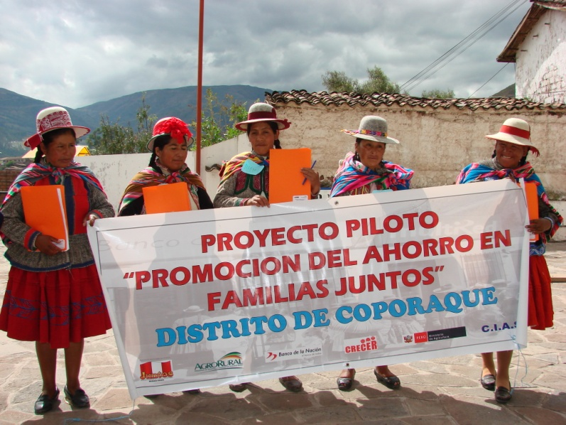
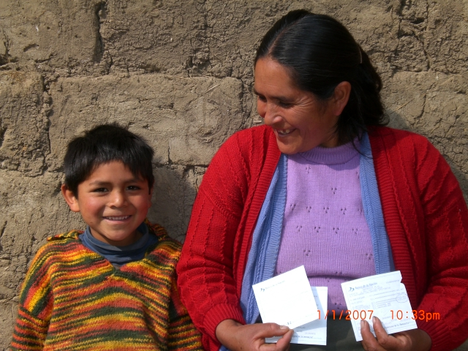
ON GOING EXPERIENCES : PERU
“SAVINGS PROMOTION AMONGST THE WOMEN BENEFICIARIES OF JUNTOS”
2009 2 pilots began in Coporaque and San Jerónimo (3821 beneficiaries)
ACTORS:
COMPONENTS:
JUNTOS
BANCO DE LA NACIÓN
AGRORURAL
ST-CIAS
CARE - Perú
1
FINANCIAL EDUCATION
INCENTIVES (RAFFLES)
FINANCIAL ASSISTANCE BY PROMOTORS
2
3
“UN AÑO AHORRANDO”

Slide 13
PERU : PRELIMINARY RESULTS

Slide 14
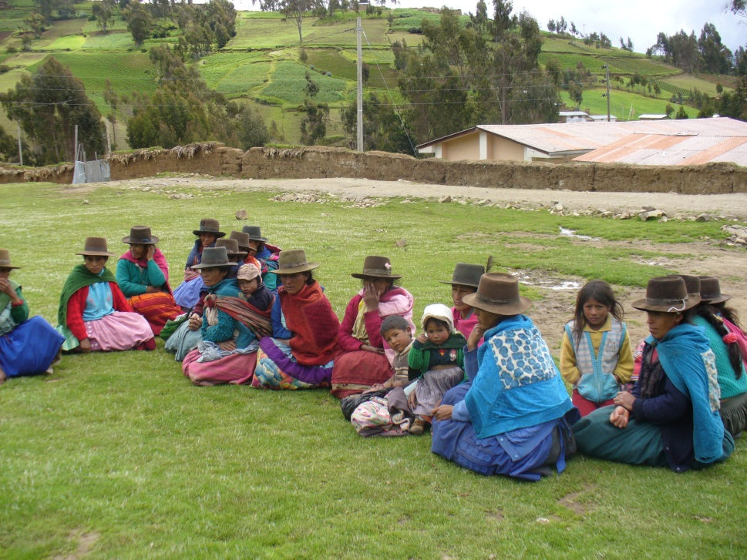
PERU : PRELIMINARY RESULTS
Beneficiaries see savings accounts as a tool:
1
Allows them to use their money in better ways and in different time periods
Helps them to deal with emergencies (health, education, etc.)
Keeps some resources immobilized in the account so they can invest it (expand income generating opportunities)
2
3
Empowerment
FOR NOWTHE MAIN SOURCE OF SAVINGS COME FROM THE JUNTOS CCT

Slide 15
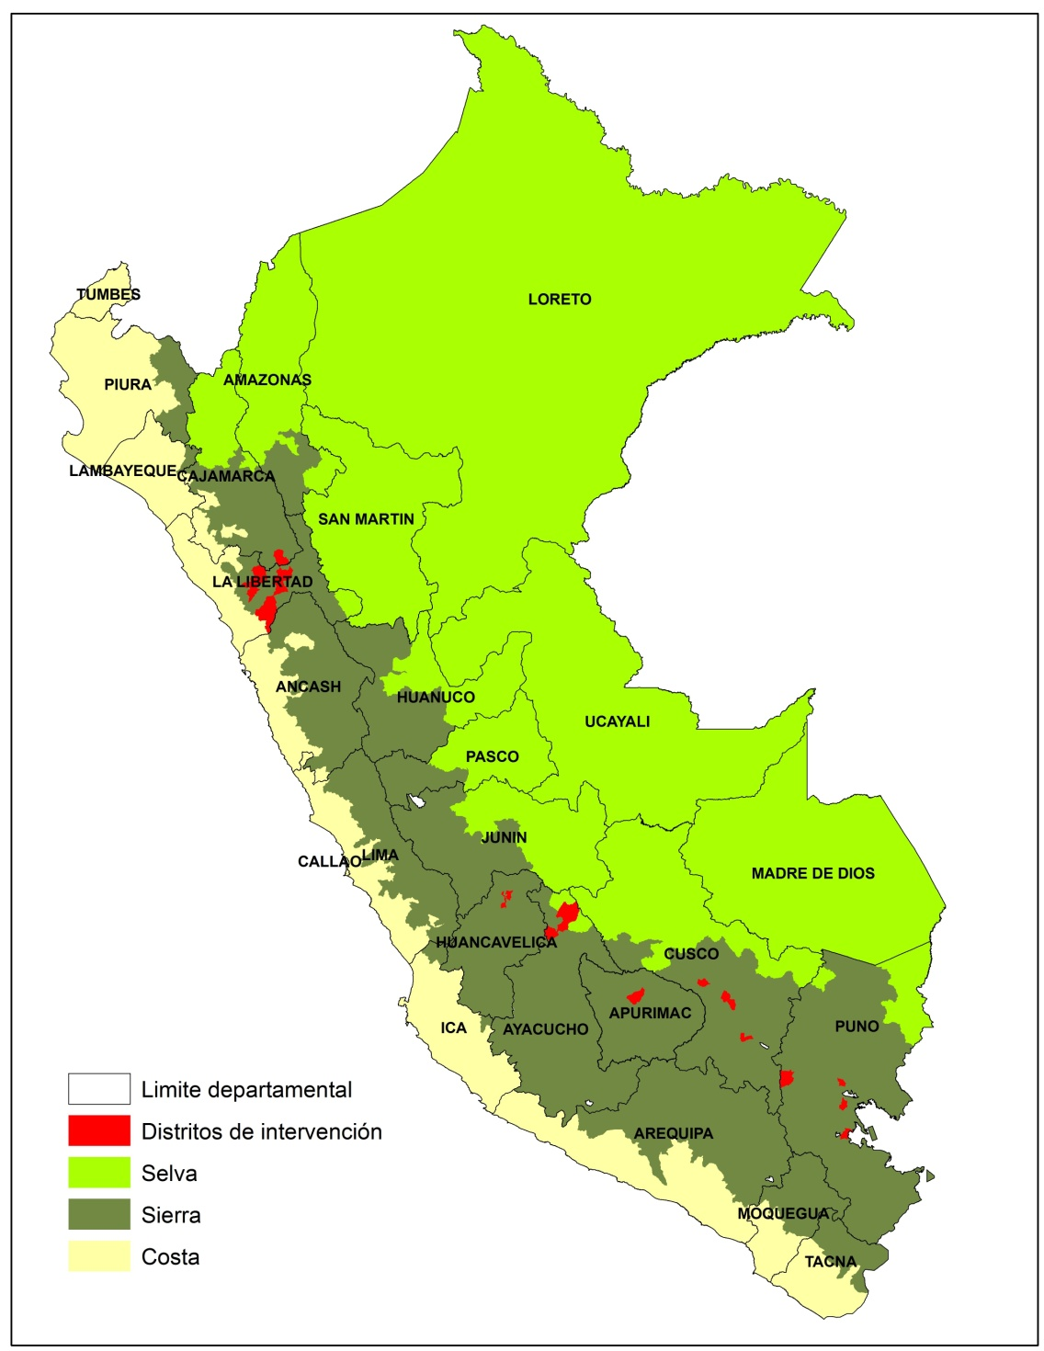
PERU: SCALING UP
EXPANSION TO 24 DISTRICTS:
2010 24.366 BENEFICIARIES
Care Peru join the initiative in Ayacucho - PUMRI
SAME COMPONENTS:
FINANCIAL EDUCATION +
INCENTIVES+
ASSITANCE OF FINANCIAL PROMOTERS
JUNE 2010: BASELINE SURVEY

Slide 16
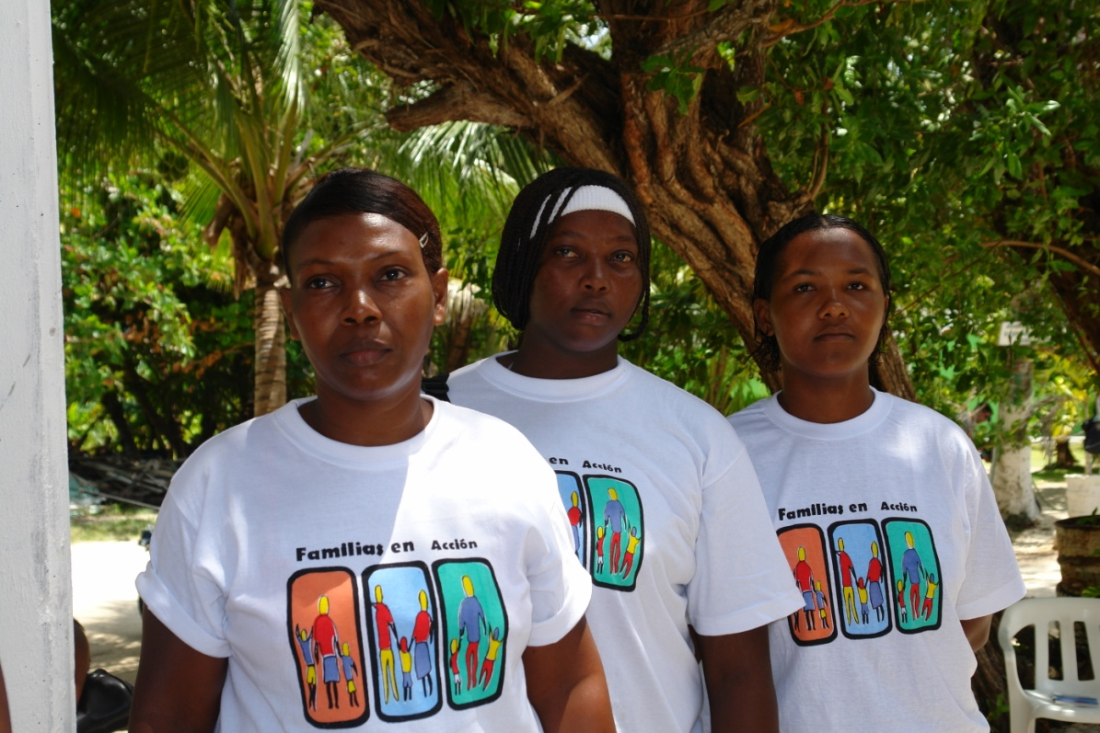
ON GOING EXPERIENCES : COLOMBIA
12 Districts (58 434 Beneficiaries)
Different interventions:
-Account
-Financial Education
-incentive : “MULTIPLICA TU SALDO”
ACTORS
BANCA DE LAS OPORTUNIDADES
BANCO AGRARIO
ACCIÓN SOCIAL
DNP
RED JUNTOS
EVALUATION
“UN AÑO AHORRANDO” (August 2011)
August 2010
Baseline Survey

Slide 17
COLOMBIA: PRELIMINARY RESULTS
Before Intervention
After Intervention

Slide 18
ONGOING EXPERIENCES: CHILE
ACTORS
FOSIS
MIDEPLAN
Programa Puente
Banco Estado
Universidad de Chile
J-PAL
Evaluation & Base Line Design
Pre Pilot in Cerro Navia
Invitation Letter to Programa Puente Families to participate in this pre pilot
90 beneficiaries applied. But only 73 were eligible for opening their accounts at Banco Estado
There was a 92% take up
PILOT WILL BEGIN SOON…

Slide 19
IN CLOSING…
CCT recipients use the accounts: They do save.
Multiple and complementary uses for the account are valued:
-Transactional device
-Reduces time required to obtain transfer
-Allows the use of resources in different time periods
Formal financial savings help vulnerability reductions amongst the poor
BUT ….
CCT Programs must be aligned with the “savings” idea.
Banks have to supply adequate products (cost, characteristics), give information, offer complementary products and facilitate their use (ATMa, mobile banking, correspondents, etc.)
Financial Education Programs are necessary –crucial– to accomplish the task.
The challenge is how to go massive, how to allow every poor to have access to an account and use it!

Slide 21
MOVING FORWARD: SAVINGS LINKED CCTs
Carolina Trivelli
Instituto de Estudios Peruanos
September 2011

